Slide 1
OBJECT-ORIENTED PROGRAMMING
C#.NET basics2

Slide 2
C#.NET Basics
Functions in C#
A function is a group of related instructions that performs a specific task.
Types of Functions in C#:
Built-in Functions
User-Defined Functions
All the predefined functions in C# are contained limited tasks only i.e. for what purpose function is designed for the same purpose it should be used.
The User-defined functions in C# are the functions that are created by the programmer so that he/she can use it many times. It reduces the complexity of a big program and optimizes the code.

Slide 3
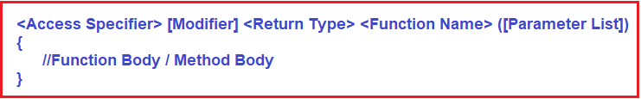
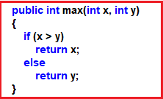
C#.NET Basics
User-Defined Function in C#
Create
Example to Create User-Defined Function in C#:
Notes:
Function Name: It is mandatory and it defines the name of the method or function. The method signature consists of the method name and parameter list. The Methods are identified by their name. The rules for giving function names are the same as the rules for giving the variable names. Same rules you should follow for giving function names also.
Parameter List: It is Optional and it defines the list of parameters. A function can take 0 or more parameters means it may not take any input.
Return Type: It is Mandatory and it defines the return type value of the method. A function may or may not return a value but it can return at most one value. It cannot return multiple values but it can take multiple values as parameters. If the function is not returning any value, then the return type should be void.
Access Specifier: It is Optional and it defines the scope of the method. That means it defines the accessibility of the method such as private, protected, public, etc.
Modifier: It is optional and defines the type of access to the method. For example, static, virtual, partial, sealed, etc. If you declare the method with a static modifier, then you can access the method directly without creating an instance. If you declare the method with the sealed modifier, then this method is not going to be overridden under a child class. And if you declare the method with the partial modifier, then you can split the method definition into two parts.
Function Body: The body of the function defines the code or list of statements that you need to execute the function call. It is enclosed within curly braces.

Slide 4
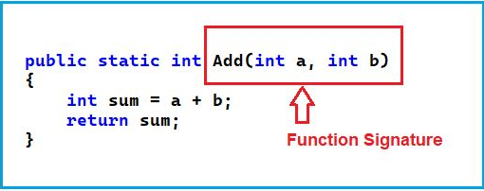
C#.NET Basics
What is Function Signature in C#?
In C# programming language, a Method Signature is consisting of two things i.e. the Method Name and the Parameter List.

Slide 5
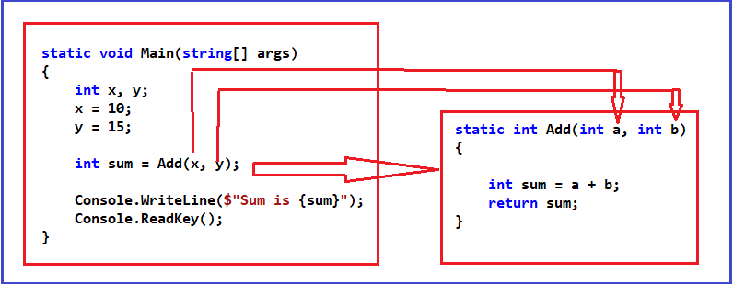
C#.NET Basics
How to Call a Method in C#?

Slide 6
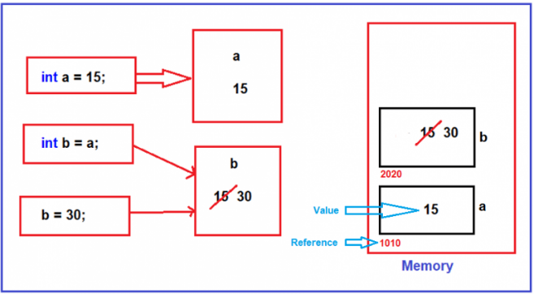
C#.NET Basics
Call by Value and Call by Reference in C#
Call By Value in C#
Call by value with Variable types in c#
static void Main(string[] args)
{
int a = 15;
int b = a;
b = 30;
Console.WriteLine(a);
Console.ReadKey();
}

Slide 7
C#.NET Basics
The same thing is also happening when we pass value types to methods.
static void Main(string[] args)
{
int a = 15;
UpdateValue(a);
Console.WriteLine(a);
Console.ReadKey();
}
private static void UpdateValue(int b)
{
b = 30;
}

Slide 8
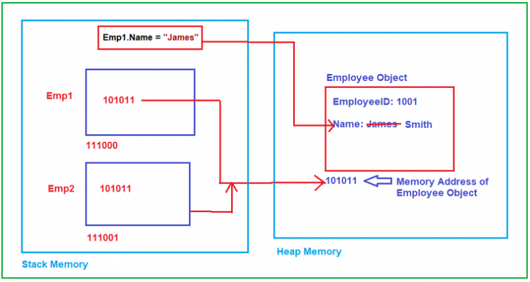
C#.NET Basics
Call by Value with Reference Types in C#
static void Main(string[] args)
{
Employee Emp1 = new Employee();
Emp1.EmployeeID = 1001;
Emp1.Name = "James";
Employee Emp2 = Emp1;
Emp1.Name = "Smith";
Console.WriteLine($"Emp1 Name = {Emp1.Name}");
Console.WriteLine($"Emp2 Name = {Emp2.Name}");
Console.ReadKey();
}
public class Employee
{
public int EmployeeID;
public string Name;
}

Slide 9
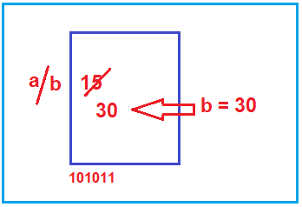
C#.NET Basics
Call By Reference in C#
Call by Reference with Value Types in C#
static void Main(string[] args)
{
int a = 15;
UpdateValue(ref a);
Console.WriteLine(a);
Console.ReadKey();
}
static void UpdateValue(ref int b)
{
b = 30;
}

Slide 10
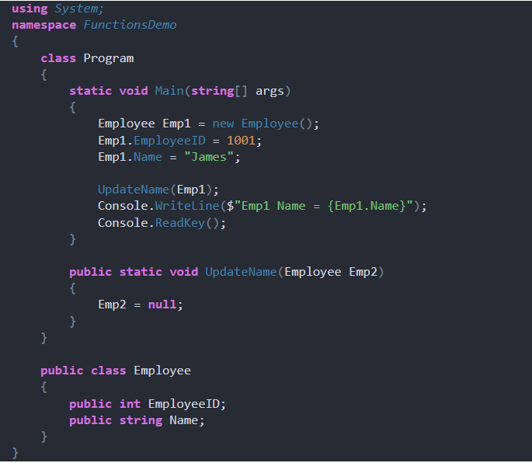
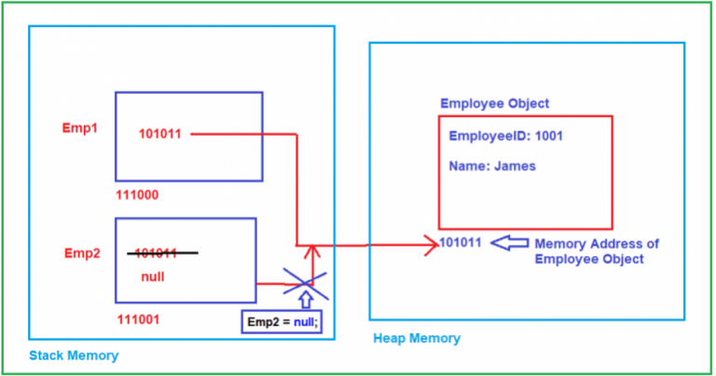

Slide 11
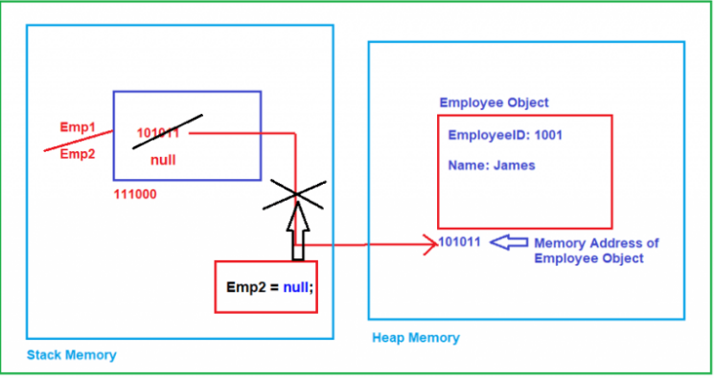
static void Main(string[] args)
{
Employee Emp1 = new Employee();
Emp1.EmployeeID = 1001;
Emp1.Name = "James";
UpdateName(ref Emp1);
Console.WriteLine($"Emp1 Name = {Emp1.Name}");
Console.ReadKey();
}
public static void UpdateName(ref Employee Emp2)
{
Emp2 = null;
}
}
public class Employee
{
public int EmployeeID;
public string Name;
}

Slide 12
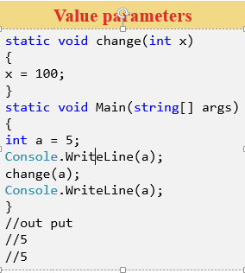
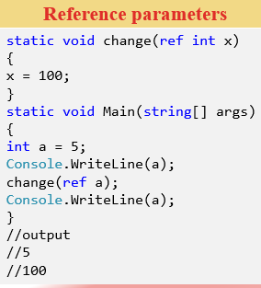
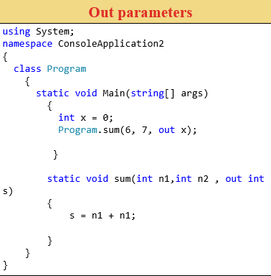
C#.NET Basics
Parameter Types

Slide 13
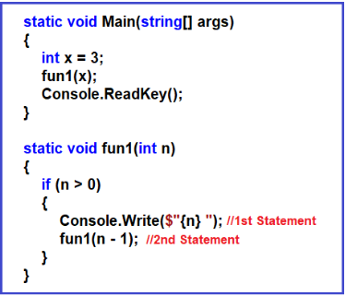
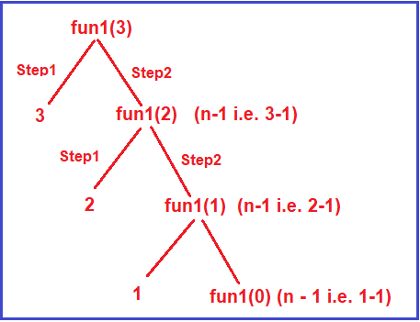
C#.NET Basics
Recursion in C# with

Slide 14
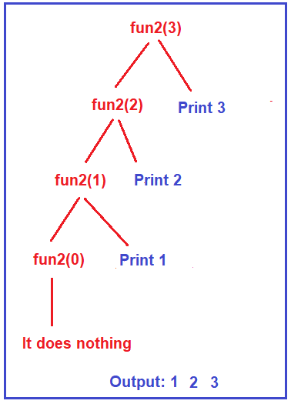
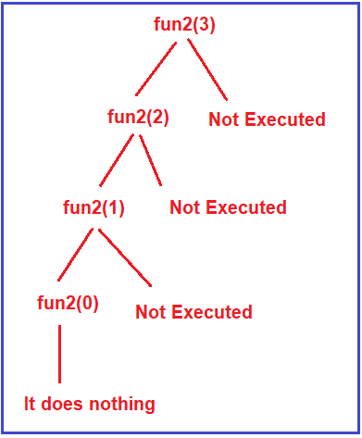
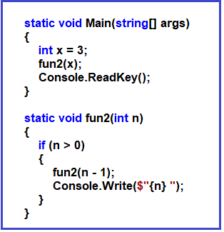
C#.NET Basics

Slide 15
C#.NET Basics
String in C#
In C#, the string is an object of the String class that represents a sequence of characters.
Strings in C# are reference types i.e. they are not normal data types or you can say they are not like other primitive data types.
Strings are Immutable in C#.

Slide 16
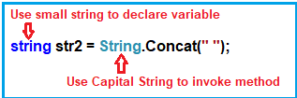

C#.NET Basics
What are the Differences between String(Capital) vs string(small) in C#?
You can use any one of them i.e. either string or String. But as per the naming convention when you are creating a variable use the small string (i.e. string) and whenever you want to invoke methods on the string then use the capital string (i.e. String) as shown in the below image

Slide 17
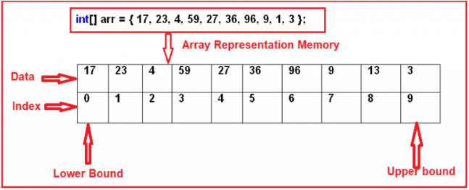
C#.NET Basics
Array in C#
An array as a collection of similar types of values that are stored in sequential order i.e. they are stored in a contiguous memory location.
Types of Arrays in C#:
Single dimensional array
Multi-dimensional array
Memory Representation of Arrays
in C#.

Slide 18
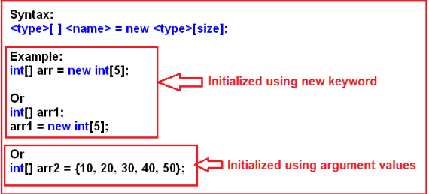
C#.NET Basics
One Dimensional Array in C#
The array which stores the data in the form of rows in a sequential order is called a one-dimensional array in C#.

Slide 19
C#.NET Basics
static void Main(string[] args)
{
//Creating an array with size 6
int[] arr = new int[6];
//Here we are assigning values to array using for loop
for (int i = 0; i < 6; i++)
{
a += 10;
arr[i] = a;
}
//accessing array values using foreach loop
foreach (int i in arr)
{ Console.Write(i + " "); }
Console.ReadKey();
}
For each loop in C#:

Slide 20
C#.NET Basics
exercises 2.1
Write a program in C# Sharp to create a user define function.
Expected Output : Welcome Friends! Have a nice day!

Slide 21
C#.NET Basics
Exercises 2.2
Write a program in C# sharp to create a function to swap the values of two integer numbers.

Slide 22
C#.NET Basics
Exercises 2.1
. Write a program in C# Sharp to create a function to calculate the result of raising an integer number to another.
Test Data : Input Base number: 3 Input the Exponent : 2 Expected Output : So, the number 3 ^ (to the power) 2 = 9

